Slide 1
10X analysis of Foreign and islet reactive cd4 conventional and regulatory t cells
Sept 20, 2024

Slide 2
Question
Is the finding of little TCR sharing between Islet reactive Tconv and Treg similar in microbial reactive cells?
Can we use 10X to capture cells from multiple antigens and reduce cost?
Create a landscape of polyclonal stimulated cells to compare since non-stimulated cells cluster separately from AIM stimulated cells

Slide 3
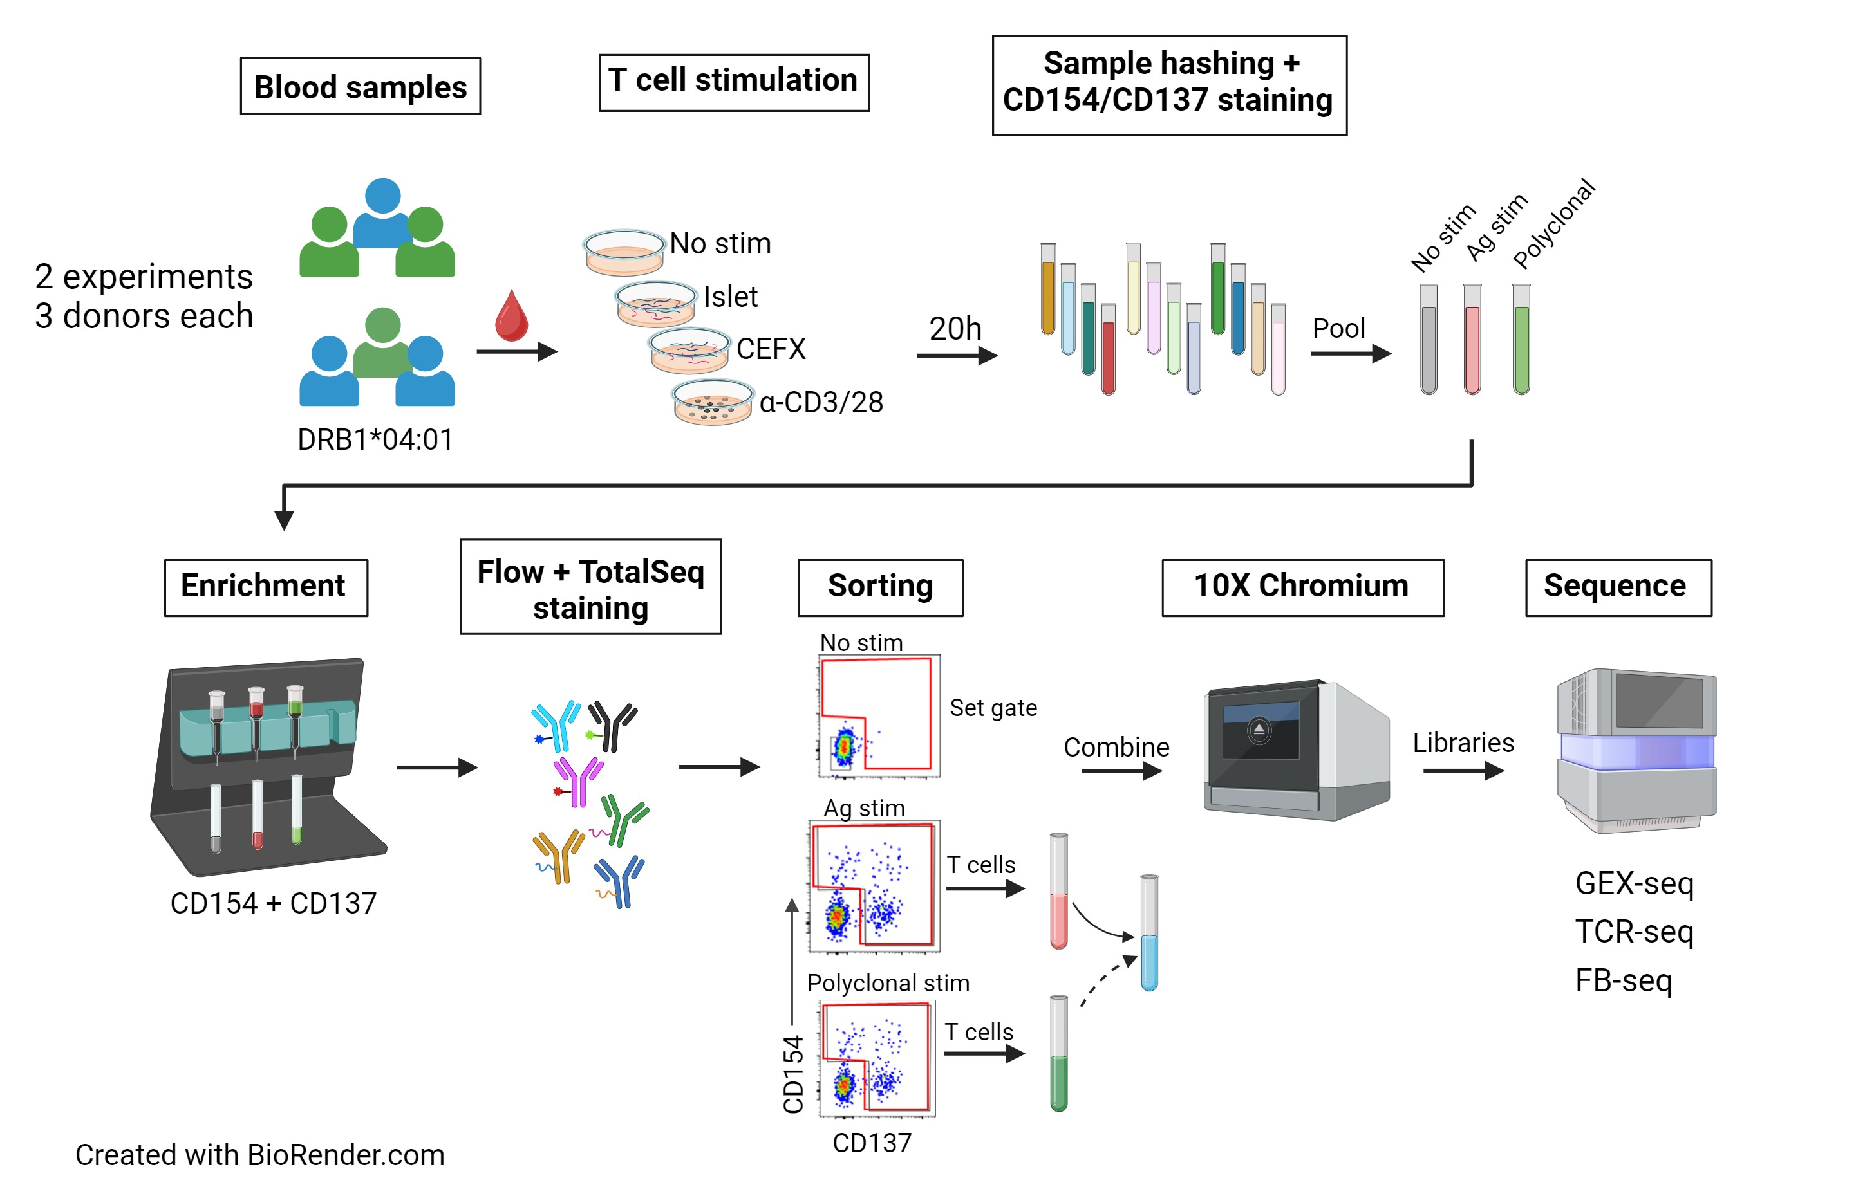
Final Experimental workflow
Notes:
GEM-X for libraries (5' GEX/TCR/ FB)
Illumina (NextSeq2000, P4 XLEAP) for sequencing
In-house alignment pipeline]

Slide 4
Antibodies
Flow Abs | TotalSeq Abs | Hastag Abs
CD3 |  | Anti-human Hashtag 1
CD4 |  | Anti-human Hashtag 2
CD8 (dump) |  | Anti-human Hashtag 3
CD19 (dump) |  | Anti-human Hashtag 4
CD14 (dump) |  | Anti-human Hashtag 5
CD56 (dump) |  | Anti-human Hashtag 6
LD |  | Anti-human Hashtag 7
CD154 | CD154 | Anti-human Hashtag 8
CD137 | CD137 | Anti-human Hashtag 9
CD69 (DMSO only) | CD69
 | CD25
 | CD127
 | CD45RA
 | CD45RO
 | CCR7
 | Mouse IgG1, κ

Slide 5
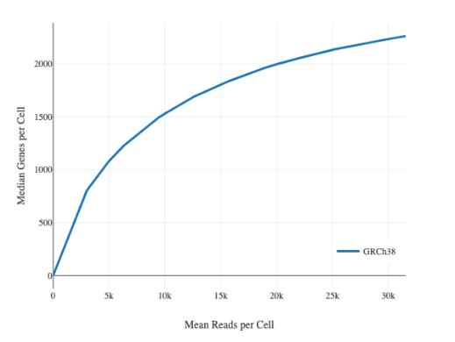
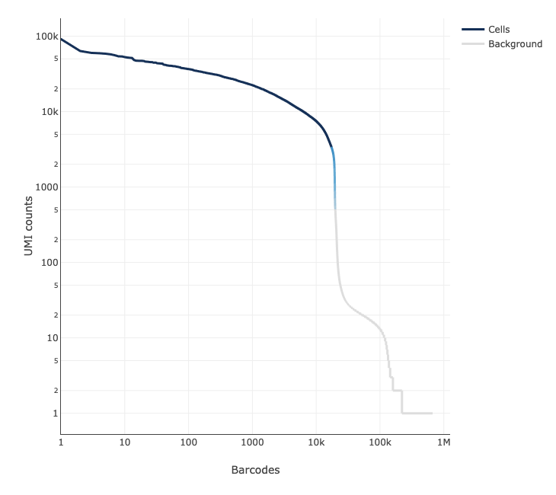
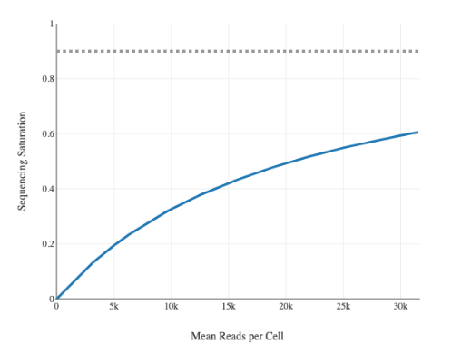
Qc overview – rna-seq
Genes vs reads/cell
Cell viability: 91%
Lower than ideal
37,420 cells recovered/ 106K loaded – between 2 batches (35%)
overloaded – target should be 20-30K per lane (capture ~20K from 10X)
2,310 median genes/cell
24,244 total genes detected
8,117 Median UMI counts/cell
GEMS with cells
Sequencing saturation
T Edwards

Slide 6
Hashtag demultiplexing
Most hashtags had good separation
37,420K cells → 1,873 Multiplet GEMs and 108 Negative GEMs identified and removed
CD3/28 hashtags were diluted previously and still worked
T Edwards

Slide 7
Cells passing qc for each hashtag
Exp | Donor Id | Islet | CEFX | CD3/28
 | # cells stimulated | 30e6 | 20e6 | 2e6
1 | CerosalettiLab448473 | 240 | 3111 | 493
1 | CerosalettiLab632811 | 388 | 1334 | 604
1 | CerosalettiLab839987 | 263 | 8612 | 279
2 | CerosalettiLab942655 | 244 | 12609 | 439
2 | CerosalettiLab1059994 | 114 | 1437 | 42
2 | CerosalettiLab1464776 | 153 | 1884 | 160
Even with decreased recovery, we still recovered more cells than previously with PlateSeq
CEFX was down-sampled to 600 for downstream analysis
Although similar numbers were set up within each stim, recovery varied
Sort stims separately or use fluorescent barcoding to ensure more even numbers
We could have stimmed fewer cells for CEFX and more for islet
T Edwards

Slide 8
Productive TCR pairs found in 80% of cells
Similar results as PlateSeq
Islet
CEFX
CD3/CD28
None ~ 5%
Alpha only ~ 9%
Beta only ~ 6%
Both ~ 80%
Removed: 35 iNKT, 11 MAIT cells, 1065 multiplets
T Edwards

Slide 9
Distinct transcript profiles revealed by rna-seq
No sample/ batch effect; polyclonal CD4 cell landscape integrated with AIM+ cells
0
6
Mostly CEFX
4
1
3
2
5
islet
T Edwards
Notes:
PCA clustering optimized with Davies-Bouldin, Calinski-Harabasz, and Silhouette metrics UMAP embedding optimized with scDEED

Slide 10
treg & Tconv signatures from P390
Tconv/Treg separate well
Islet
CEFX
CD3/CD28
Treg
0
Tregs are clusters 2 and 5 on the bottom of uMap
Tconv are clusters 1, 3, 4 on top right
Large cluster 0 is mostly CEFX
Expresses CD154 and CD137, FOXP3
Highly activated Tconv?
Modules were defined from islet stimmed cells
2
5
2
5
2
5
Tconv
Islet
CEFX
CD3/CD28
1
0
1
1
4
3
4
3
4
3
T Edwards

Slide 11
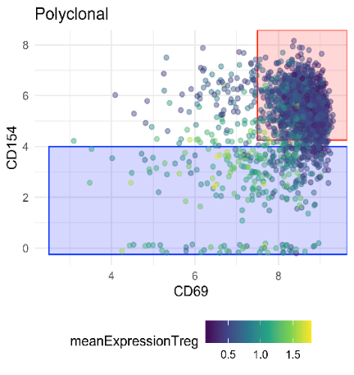
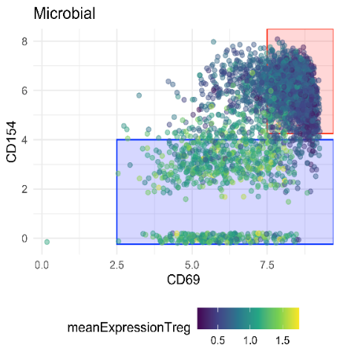
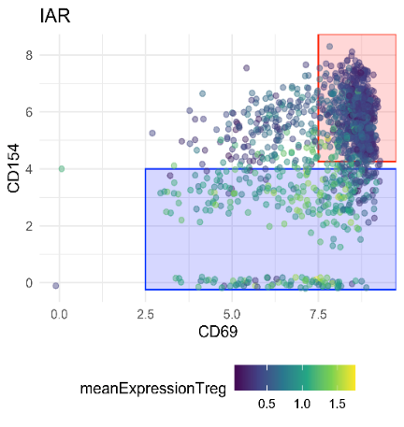
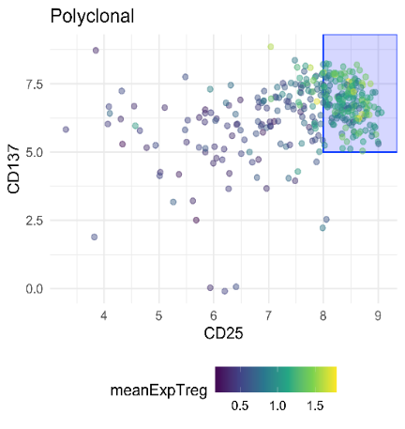
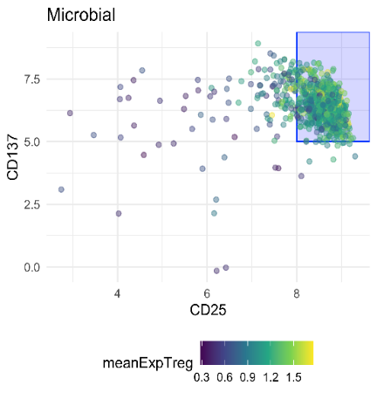
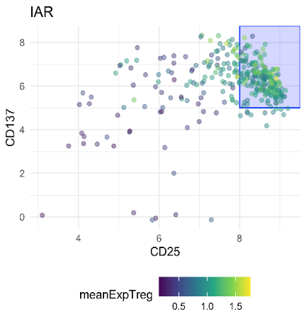
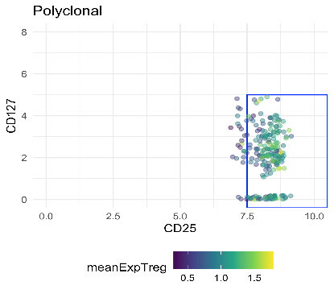
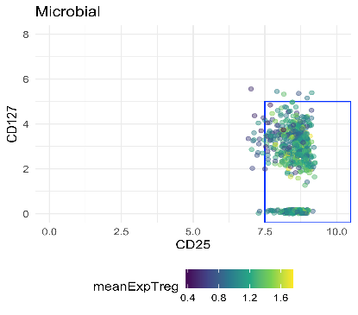
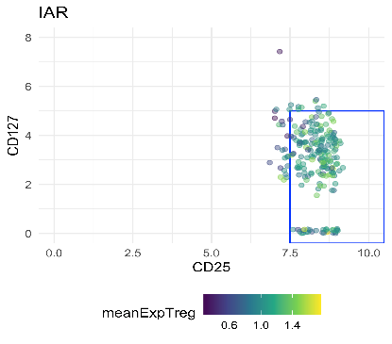
CITE-Seq “gating” on AG reactive cells
CD3/CD28
CEFX
Islet
CD154
CD69
CITE-seq antibodies
Gating without DMSO control slightly more difficult
New approach
Select cells from RNAseq clusters that are Tregs
Then gate with CITE-seq abs for CD154-CD137+CD25+CD127lo
CD137
CD25
CD127
CD25

Slide 12
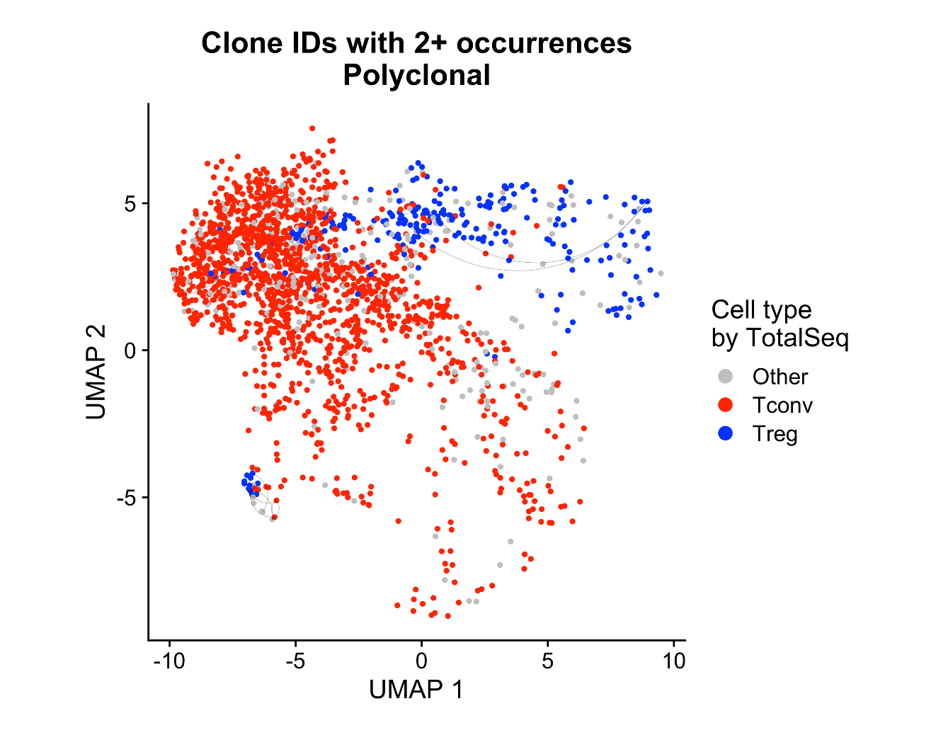
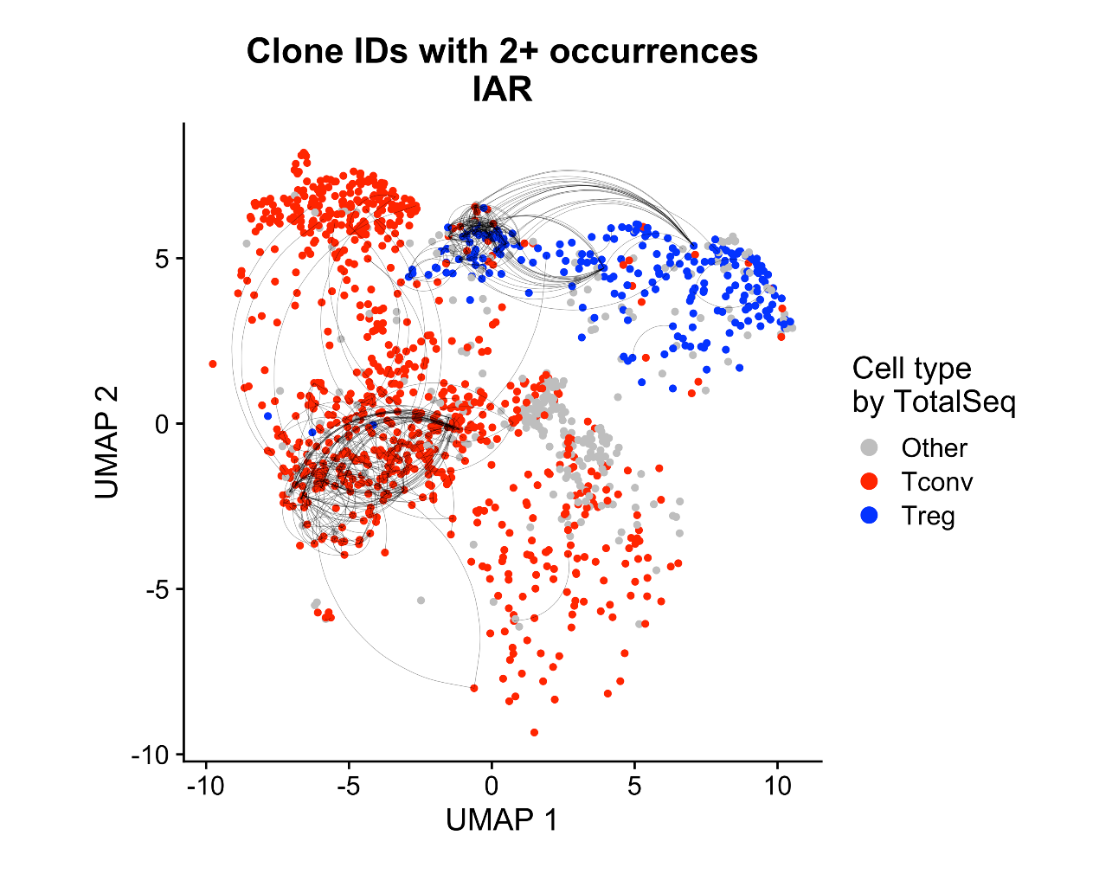
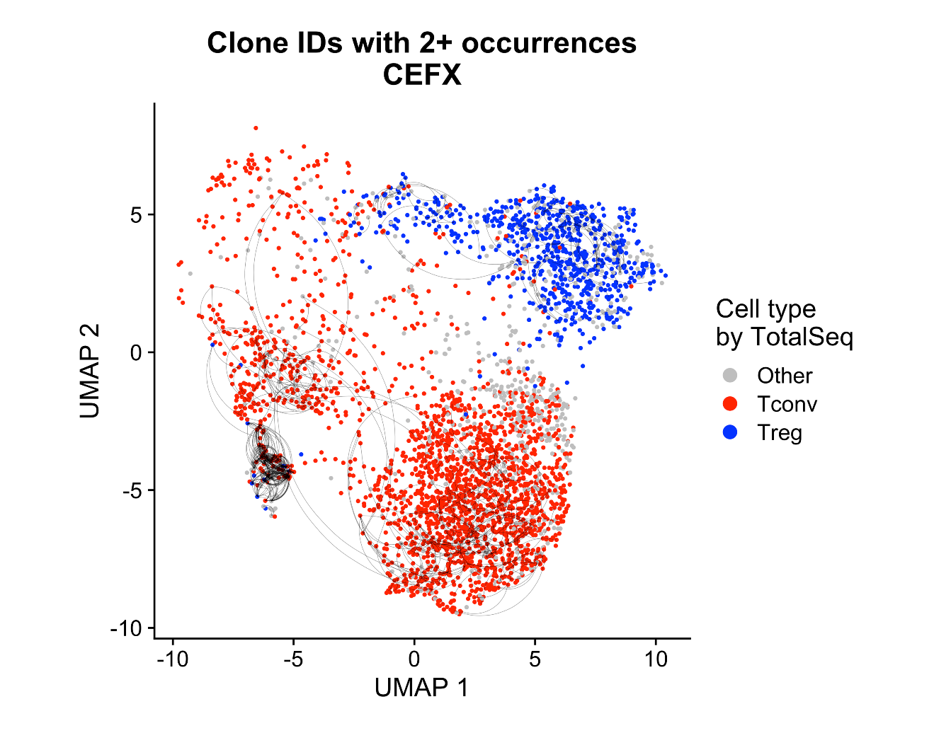
Clonal expansion shown little sharing between Treg and Tconv
CD3/28
Islet
CEFX
TCR chains found in ≥2 cells

Slide 13
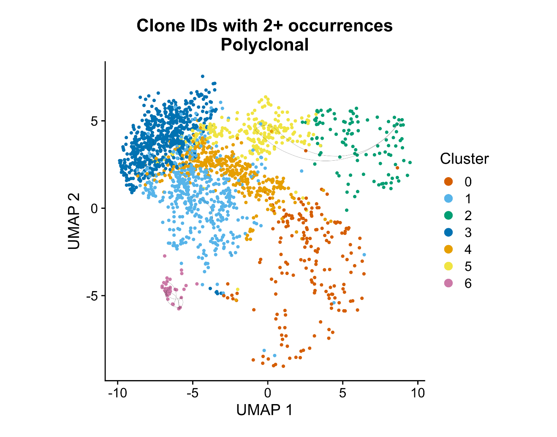

Airline plots—totalseq gating—polyclonal stim

Slide 14
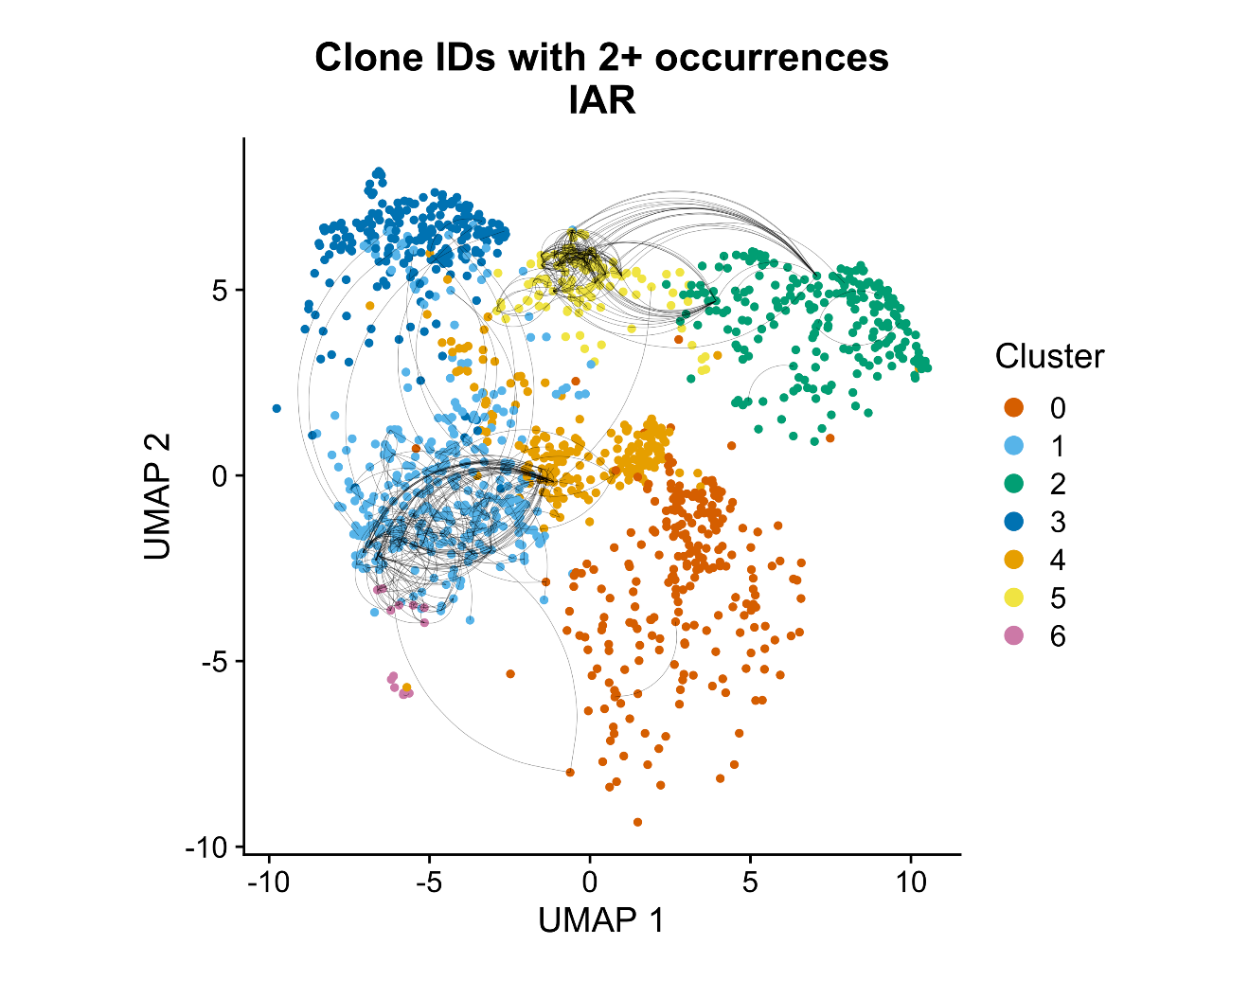

Airline plots—totalseq gating—IAR stim

Slide 15
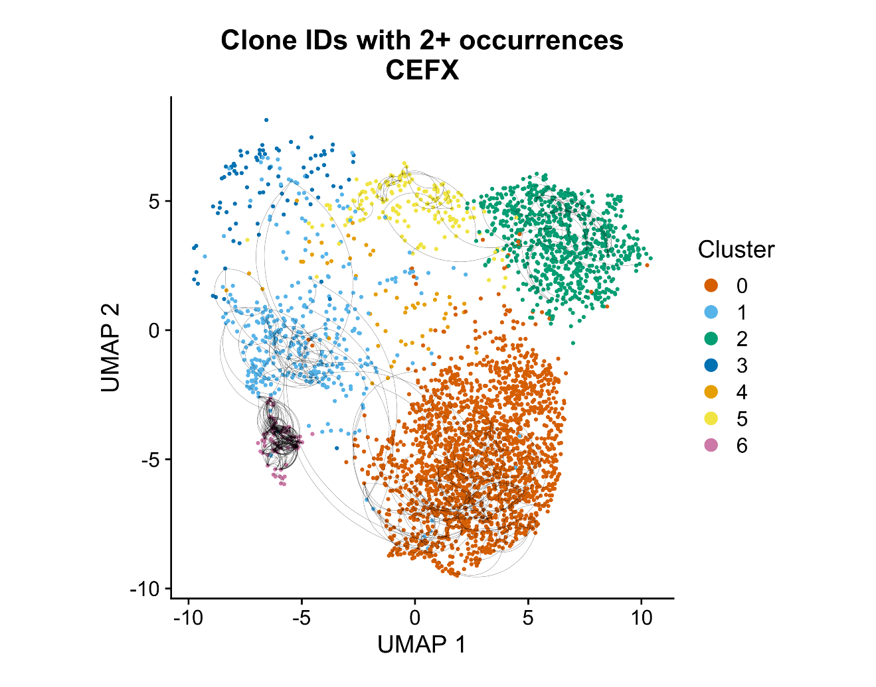
Airline plots—totalseq gating—cefx stim

Slide 16
Conclusions and IDAD considerations
10X of AIM assay was successful
Multiple samples can be prepared in one day, hashtagged, and combined
10X cell capture was poor, 35%, but chip was loaded on high end (50K)
We were able to test multiple stimulations
Polyclonal stimulated CD4 works well as a landscape of all CD4 T cells as they co-cluster with AIM stimulated cells
Ag specific but not polyclonal stimulated T cells show clonal expansion
Little TCR sharing between Tconv and Treg cells
IDAD
Full CITE-seq panel, plus markers identified from RNA-seq (intracellular markers)
Stimulations islet, CD3/28, other?
Banked samples, lower viability than fresh > fewer cells (stimulated 30e6 for islet this exp, 2e6 CD3/28)

